Slide 1
Back End Engineering-I Project
Registration Form
TEAM DETAILS:
Raghav Verma 2310992187(G-25) raghav2187.be23@chitkara.edu.in
Pushkar Garg 2310992185 (G-25) pushkar2185.be23@chitkara.edu.in
Samarth Kapoor 2310992202 (G-25) samarth2202.be23@chitkara.edu.in
Sahil Sanjay Singh 2310992524 (G-25) shahil2524.be23@chitkara.edu.in
Supervised By Batch-2023; G-25; Semester - IV
Internal Faculty: Dr. Shikha Project Id: 17
External Faculty: Mr.Vikas Patel
:
Chitkara University Institute of Engineering and Technology,
Chitkara University, Punjab

Slide 2
Table of Contents
Introduction
Technical Details
Code Snippets
Output
Project GitHub Link

Slide 3
Introduction
Project Overview: A simple web application where users can submit their details through a form, which are then captured and stored in a backend system (Node.js) using JSON format.
Purpose: To demonstrate how to connect the frontend with the backend, handle user input, and store/retrieve data using HTTP requests.
Key Technologies Used:
Frontend: HTML, CSS, JavaScript
Backend: Node.js, File System (for storing data in JSON format)
Communication: Fetch API for data exchange between frontend and backend

Slide 4
Technical Details
Frontend:
HTML Form: Collects user data (name, email, etc.).
CSS: Basic styling for a responsive and user-friendly form.
JavaScript: Captures input and sends data via POST request using fetch().
DOM Manipulation: Updates UI dynamically based on backend response.
Backend:
Node.js: Sets up a simple server using http.
File System (fs): Reads and writes user data to a JSON file.
JSON File: Stores user data in a structured format (array of objects).
HTTP Requests:
POST: Sends user data from frontend to backend.
GET: Retrieves stored data from backend.

Slide 5
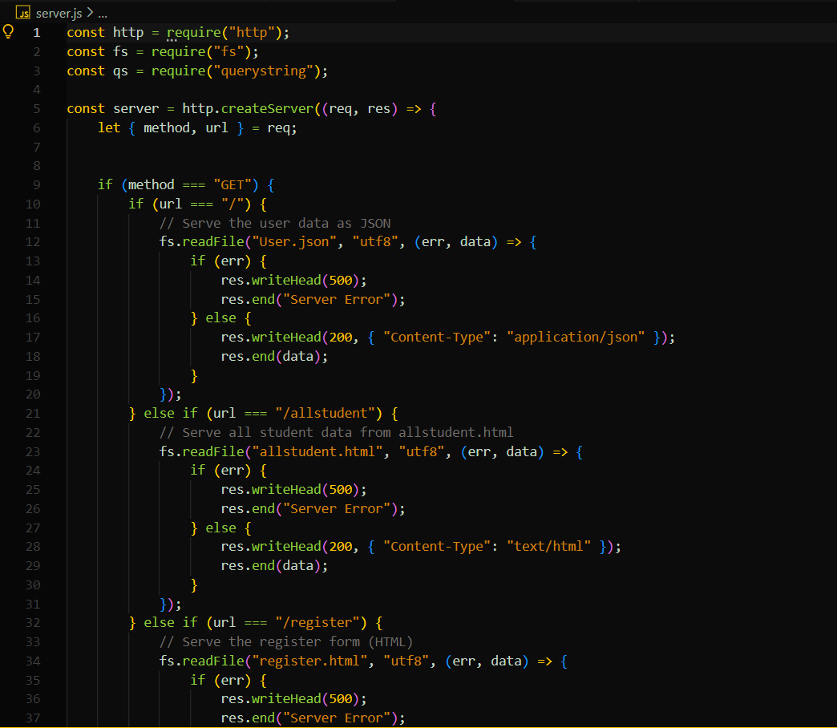
Code Snippets
Server.js

Slide 6
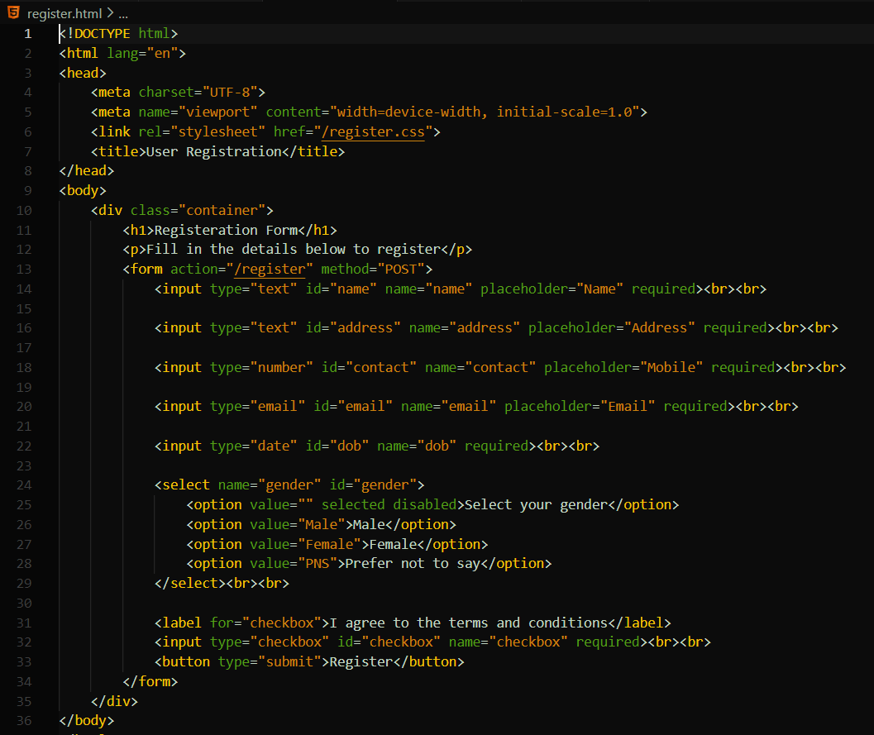
Code Snippets
Register.html

Slide 7
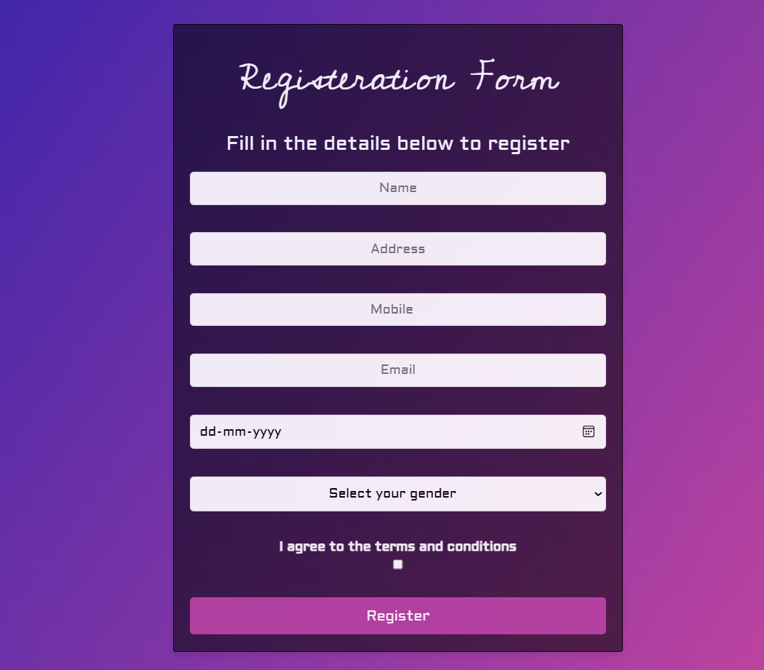
Output
Registration Form:

Slide 8
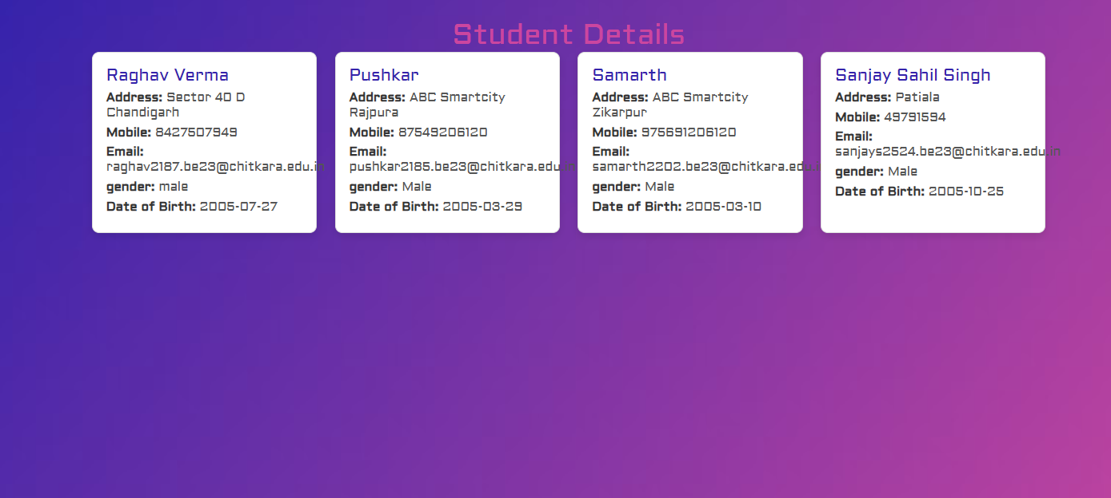
Output
All Student Data:

Slide 9
Project Github Link
Link: https://github.com/Rave271/BEE-PG19-G25

